Slide 1




SMART INDIA HACKATHON 2026
TITLE PAGE
  Problem Statement ID – 26092
  Problem Statement Title - AI-Driven Scheme Matching for Marginalized Entrepreneurs
  Theme- Smart Automation
  PS Category- Software/Hardware
  Team ID-
  Team Name- CORTEX CREW

Slide 2




IDEA TITLE
CORTEX CREW
Detailed Explanation
How It Addresses the Problem
Innovation & Uniqueness
•Entrepreneur enters category, location, sector, business stage, and a short description of their business
•Replaces manual search across hundreds of scattered scheme portals with a single guided flow
•Semantic (embedding-based) matching catches relevant schemes even when wording differs from the user's own — not just keyword search
•Each matched scheme is shown as a plain-language card: What you get, What you need, How to apply
•Converts dense legal eligibility text into short, plain-language summaries
•Purpose-built for marginalized users: voice-first, regional language, low-literacy-friendly design
•System filters schemes by hard eligibility rules, then ranks remaining schemes using NLP-based semantic matching
•Removes the language barrier through regional-language text and voice output
•Works for both individual users and NGO/CSC intermediaries assisting multiple entrepreneurs
•Combines rule-based eligibility certainty with AI-based relevance ranking
•Results available as text and voice, in English plus a regional language
@SIH Idea submission- Template
2

Slide 3

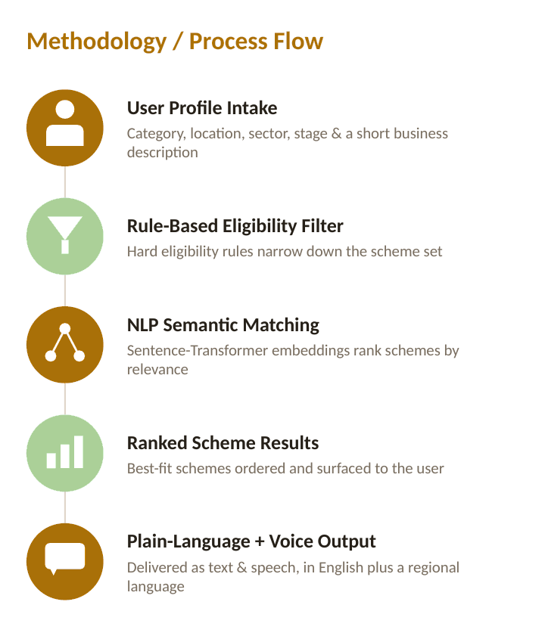
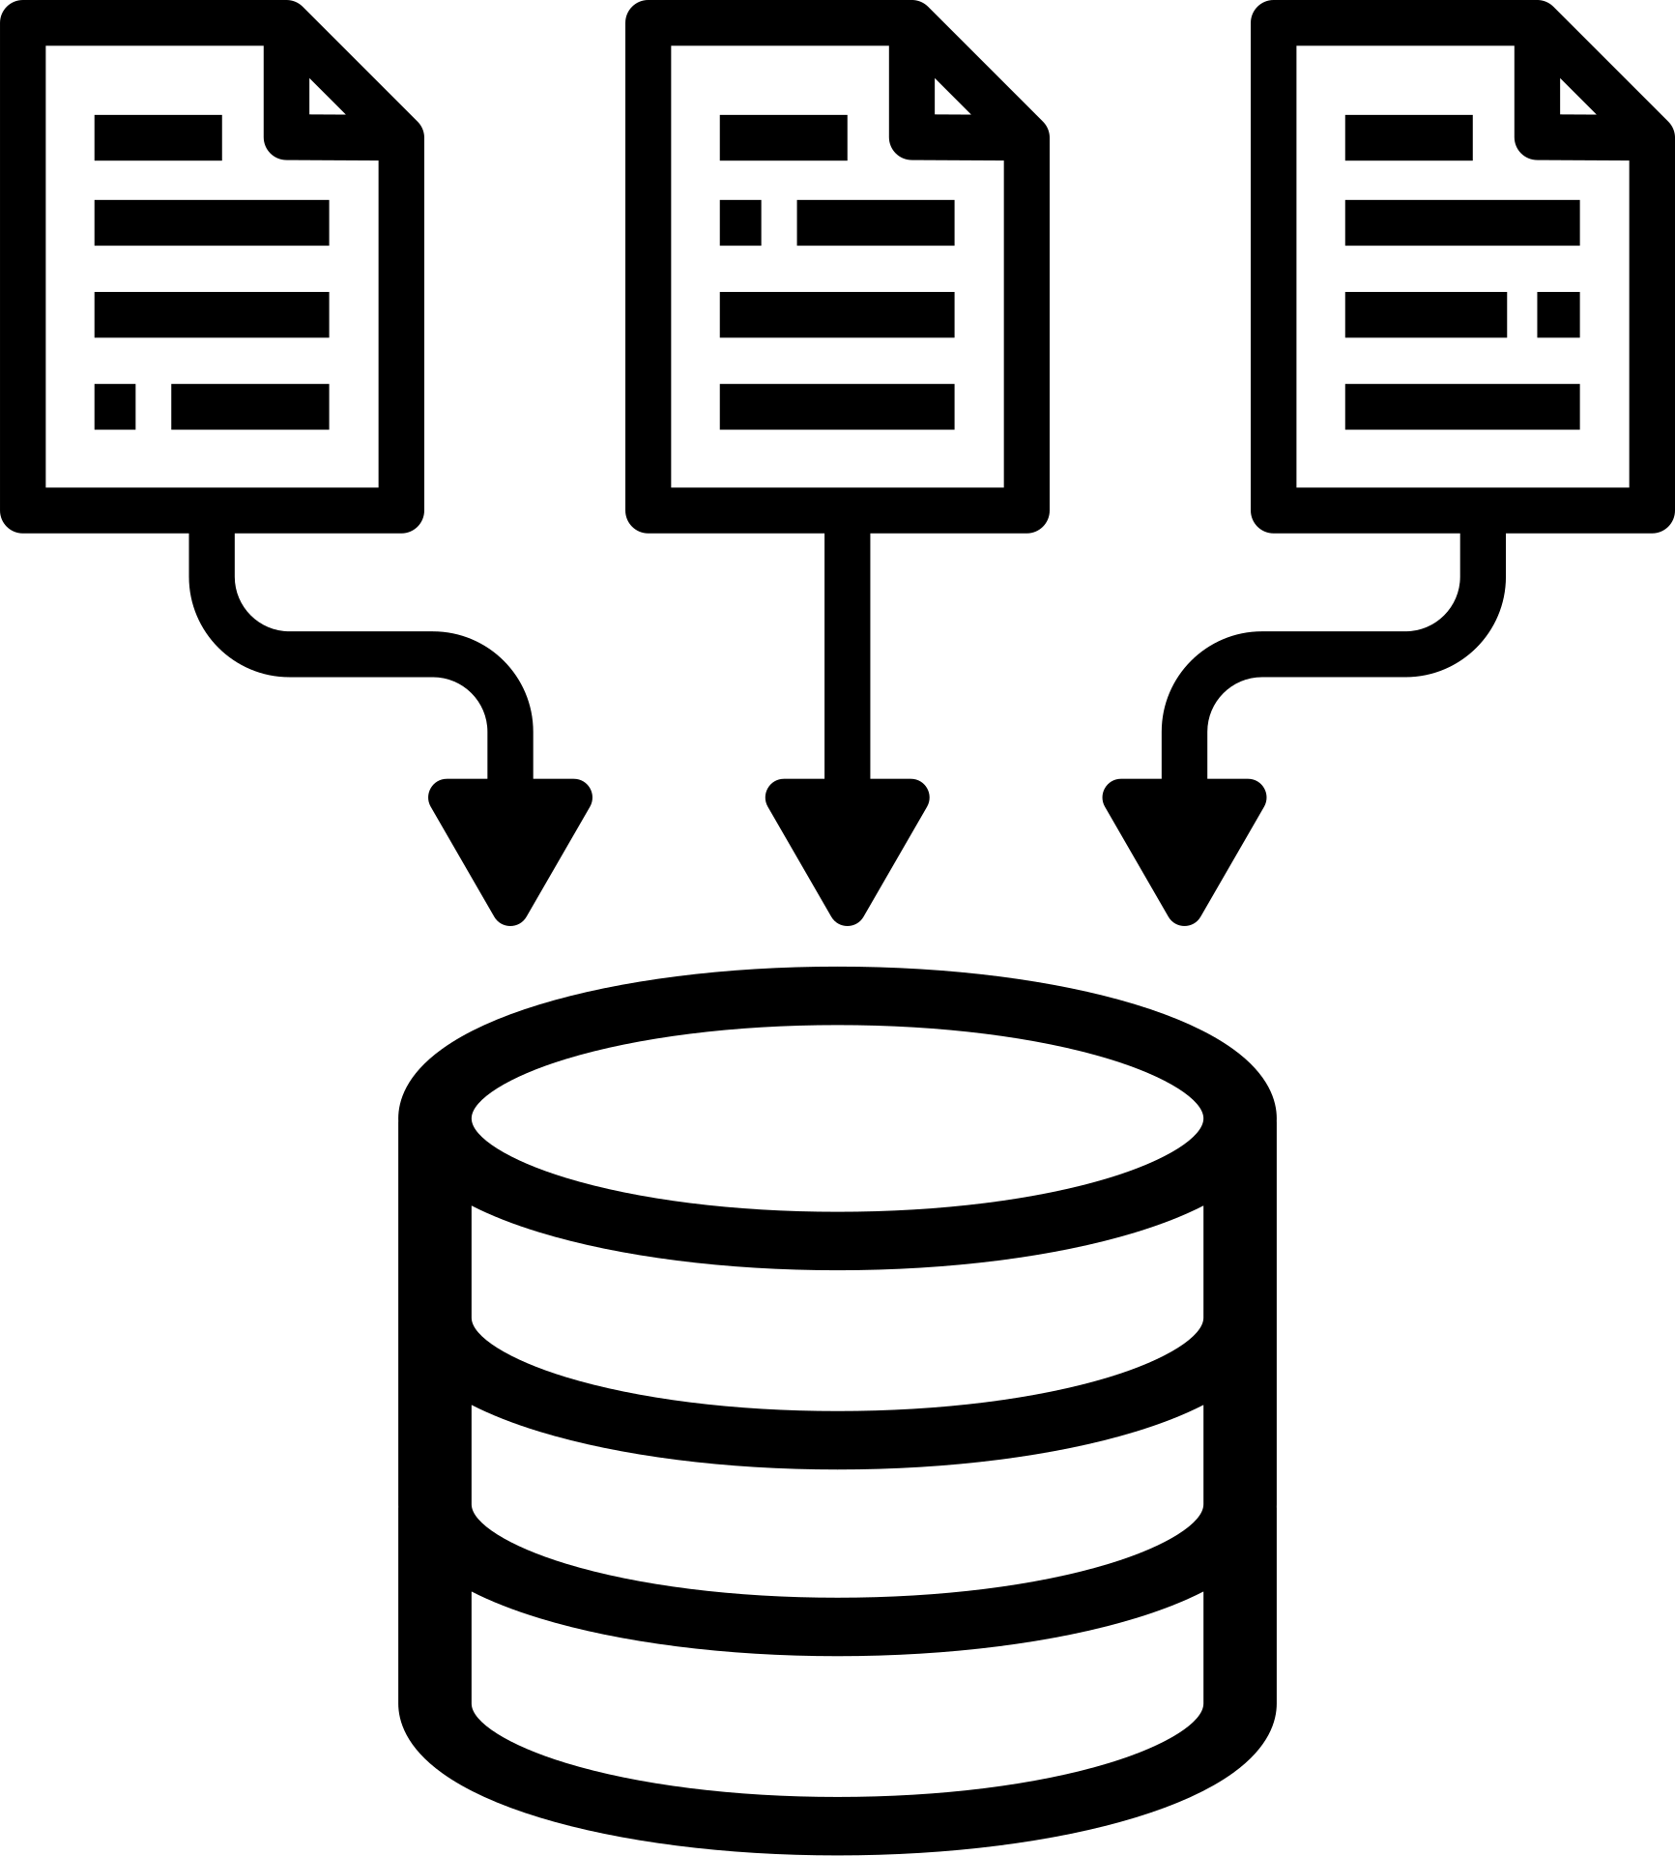

TECHNICAL APPROACH
CORTEX CREW
Technologies Used
•Frontend: React + Tailwind CSS
•Backend: FastAPI (Python)
•Database: PostgreSQL
•NLP Matching: Sentence-Transformers (embeddings + cosine similarity)
•Summarization: Pre-generated plain-language scheme summaries
•Language & Voice: Bhashini API (translation + text-to-speech)
•Optional (stretch): OCR + lightweight CNN for document auto-fill
@SIH Idea submission- Template
3

Slide 4





FEASIBILITY AND VIABILITY
CORTEX CREW
Feasibility Analysis
Challenges & Risks
Mitigation Strategies
•Core matching flow buildable within a 36-hour hackathon window
•Uses free, pre-trained embedding models — no GPU or paid infra required
•Government scheme data changes over time and needs periodic updates
•Full multilingual coverage is hard to achieve in limited time
•Design a periodic-sync pipeline (roadmap item) instead of live scraping for MVP
•Demo 1-2 regional languages convincingly rather than claim full coverage
•Live translation/LLM APIs may be slow or fail during a demo
•Scheme data is public information, easily curated for a working demo
•Pre-generate summaries and translations offline to remove live-call risk
@SIH Idea submission- Template
4

Slide 5




IMPACT AND BENEFITS
CORTEX CREW
Potential Impact on Target Audience
Social Benefit
Greater financial inclusion and dignity of access — entrepreneurs no longer excluded from benefits due to language or literacy barriers
•Cuts scheme-discovery time from hours of manual search to under 2 minutes
•Directly serves women, SC/ST, minority, and rural/informal-sector entrepreneurs who are least likely to discover schemes today
•Enables NGOs and Common Service Centres to assist many applicants efficiently through one platform
Economical Benefit
Higher scheme uptake means more capital reaching small businesses, supporting local livelihoods and job creation
@SIH Idea submission- Template
5

Slide 6
RESEARCH AND REFERENCES
CORTEX CREW
Government Scheme Data -
myscheme.gov.in — National Government Services Portal
Language AI Infrastructure -
Bhashini — Govt. of India National Language Translation Mission (bhashini.gov.in)
Semantic Matching Method -
Sentence-BERT / Sentence-Transformers — sentence embedding models for semantic similarity (SBERT.net)
PROTOTYPE- Antigravity
@SIH Idea submission- Template
6

